Slide 1
EX 1.3 BOOLEAN FUCNTIONS

Slide 2
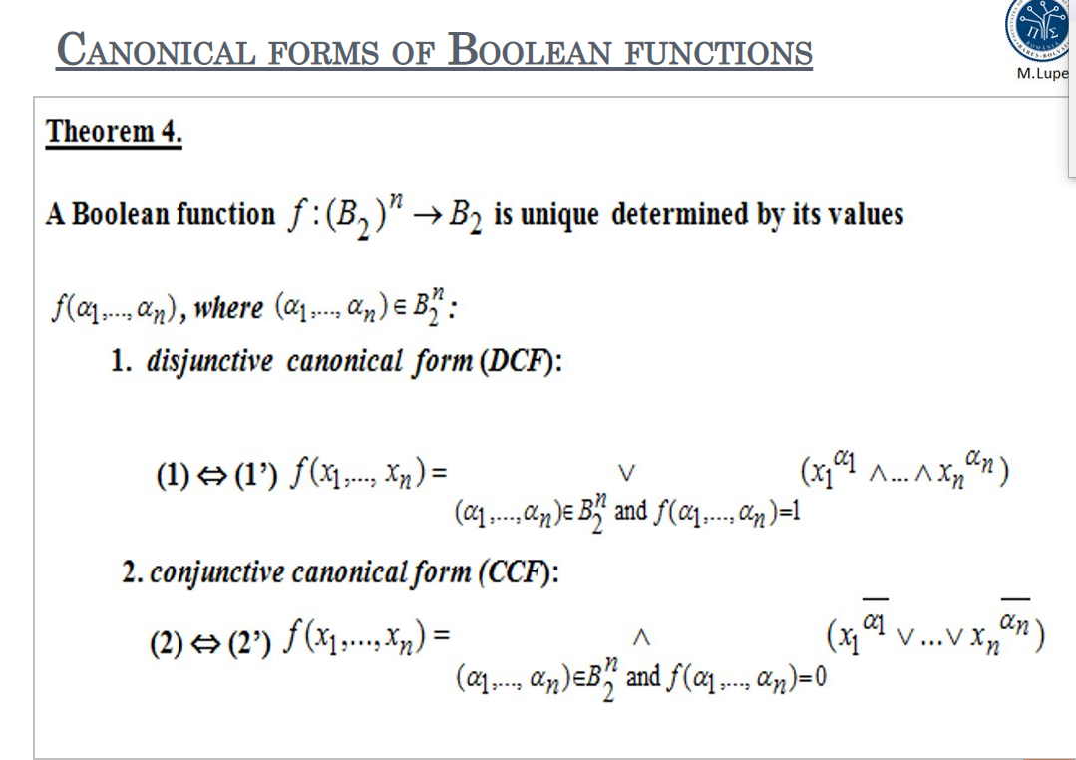
Theoretical Results

Slide 3
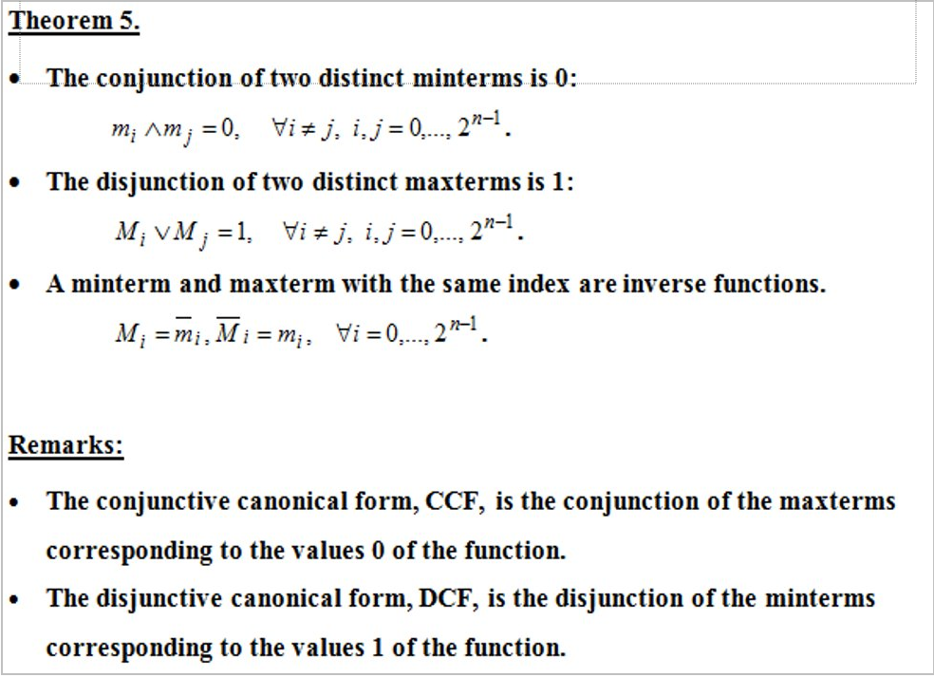

Slide 4
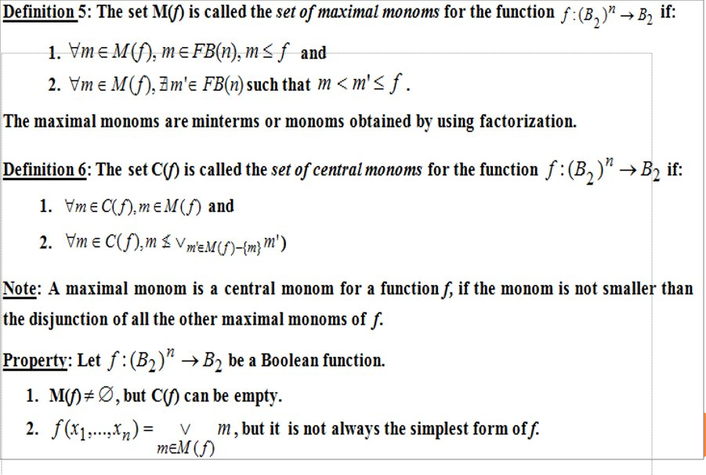

Slide 5
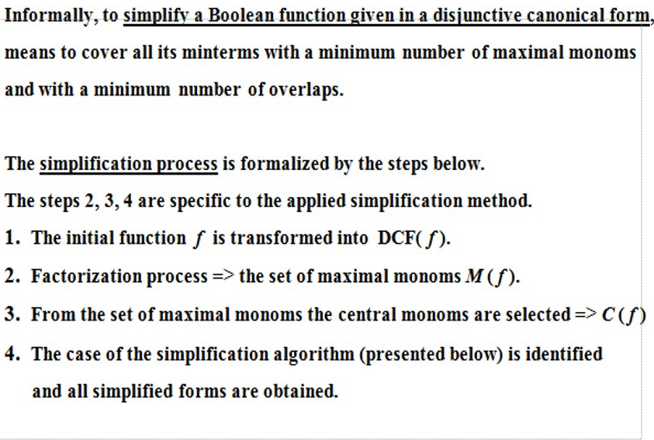

Slide 6
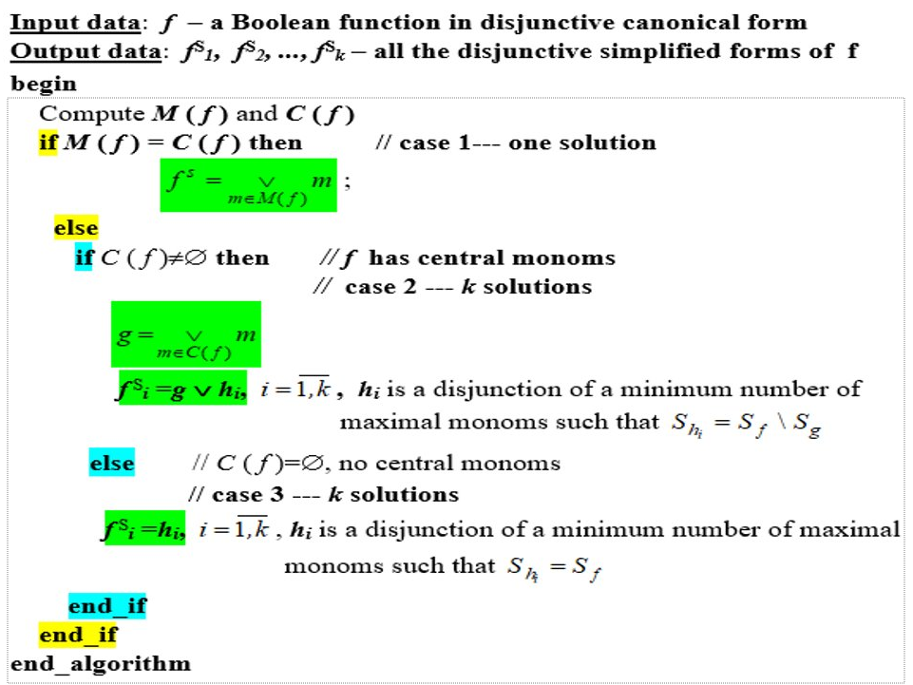

Slide 7
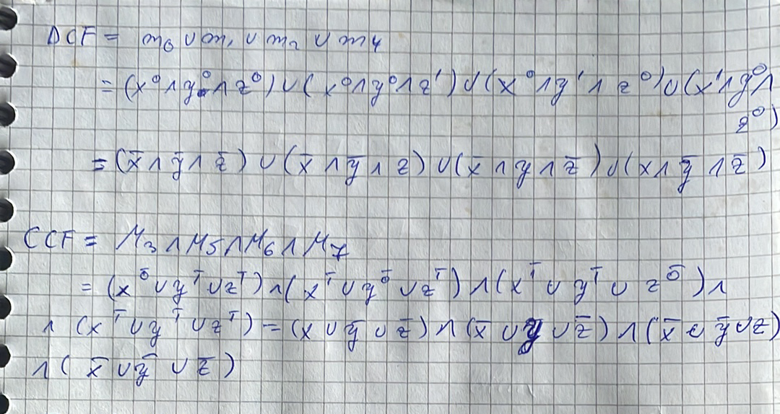
x | y | z | f | m0 | m1 | m2 | m4 | M3 | M5 | M6 | M7
0 | 0 | 0 | 1 | 1 | 0 | 0 | 0 | 1 | 1 | 1 | 1
0 | 0 | 1 | 1 | 0 | 1 | 0 | 0 | 1 | 1 | 1 | 1
0 | 1 | 0 | 1 | 0 | 0 | 1 | 0 | 1 | 1 | 1 | 1
0 | 1 | 1 | 0 | 0 | 0 | 0 | 0 | 0 | 1 | 1 | 1
1 | 0 | 0 | 1 | 0 | 0 | 0 | 1 | 1 | 1 | 1 | 1
1 | 0 | 1 | 0 | 0 | 0 | 0 | 0 | 1 | 0 | 1 | 1
1 | 1 | 0 | 0 | 0 | 0 | 0 | 0 | 1 | 1 | 0 | 1
1 | 1 | 1 | 0 | 0 | 0 | 0 | 0 | 1 | 1 | 1 | 0

Slide 8
